Slide 1
Learning Objective
I will be able to determine the instantaneous rate of change.
Success Criteria
At the end of the lesson, I will be able to:
Determine the instantaneous rate of change

Slide 2
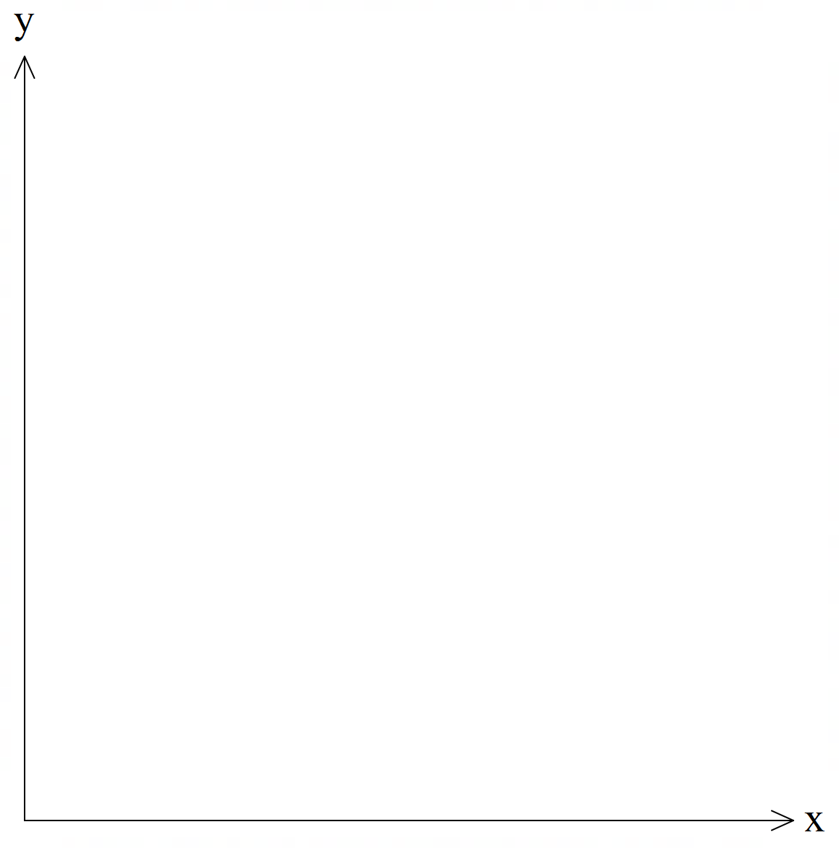
Instantaneous rate of change
Concept Development
Tangent line: A line that touches a curve at a single point and does not cross through it
A
Instantaneous rate of change:
The change in the rate at a particular instant
Draw a tangent line passing through the point
Find the gradient of the tangent line

Slide 3


Guided Practice
Estimate the instantaneous rate of change of $y$ with respect to $x$ at the point $P(2,9)$ on the curve $y=x^{3}+1$ by considering the secant $PQ$, where $Q=(2.01,{\left(2.01\right)}^{3}+1)$
G$radient of PQ=\frac{{\left(2.01\right)}^{3}+1−9}{2.01−2}$
$$Gradient=12.0601$$

Slide 4
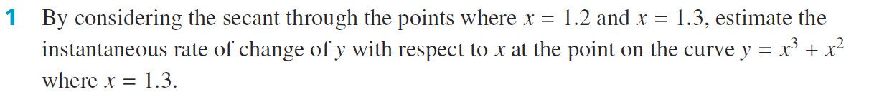
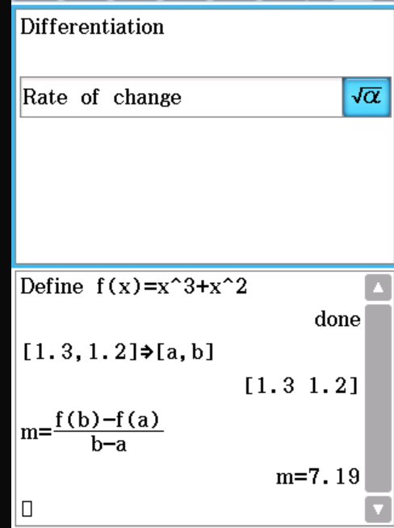



Guided Practice
G$radient=\frac{f\left(1.3\right)−f\left(1.2\right)}{1.3−1.2}$
$$f\left(1.3\right)={\left(1.3\right)}^{3}+{\left(1.3\right)}^{2}$$
$$f\left(1.2\right)={\left(1.2\right)}^{3}+{\left(1.2\right)}^{2}$$
Average rate of change$=\frac{{\left(1.3\right)}^{3}+{\left(1.3\right)}^{2}−({\left(1.2\right)}^{3}+{\left(1.2\right)}^{2})}{0.1}$=7.19

Slide 5
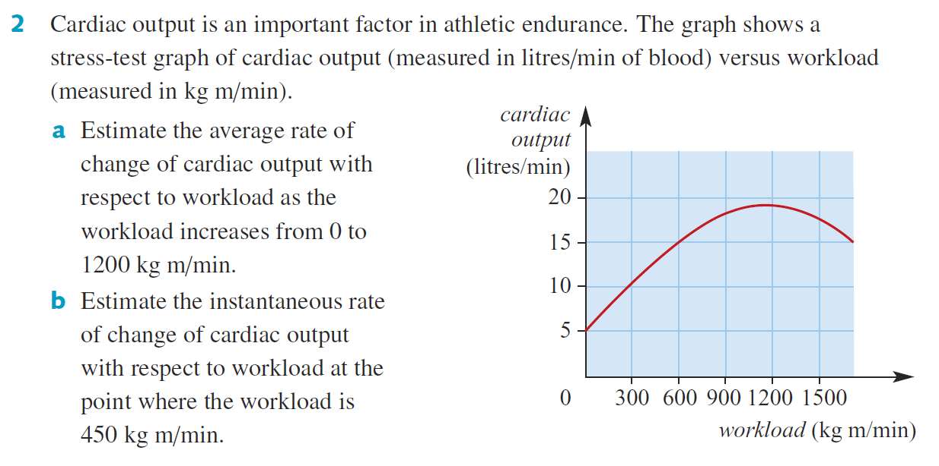
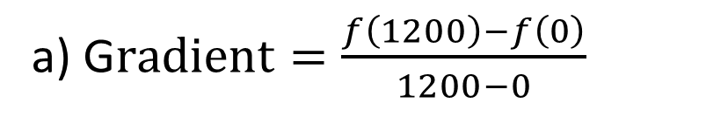

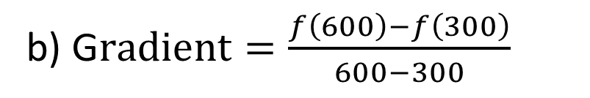
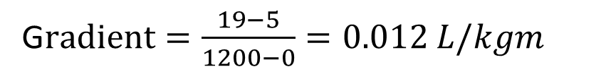
Guided Practice
a) G$radient=\frac{f\left(1200\right)−f\left(0\right)}{1200−0}$
G$radient=\frac{19−5}{1200−0}=0.012 L/kgm$
b) G$radient=\frac{f\left(600\right)−f\left(300\right)}{600−300}$
G$radient=\frac{15−10}{300}=0.0167 L/kgm$
Note: Choose 2 points close to the point you are trying to find.

Slide 6
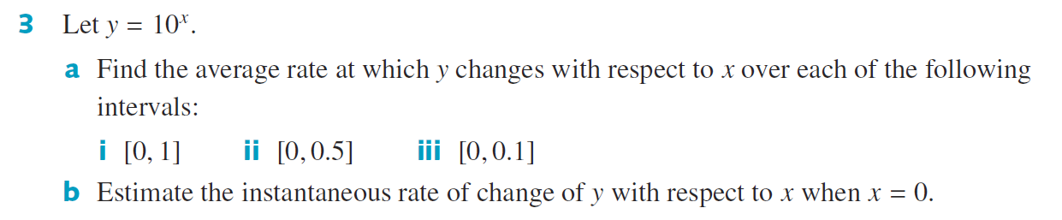
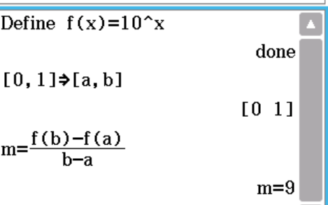
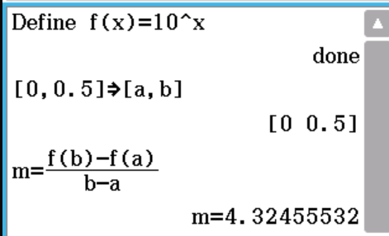
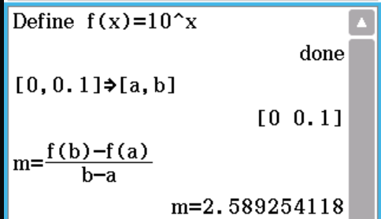
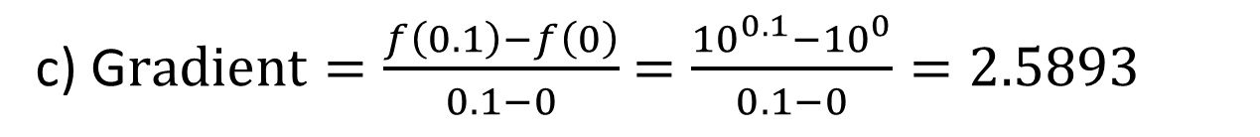
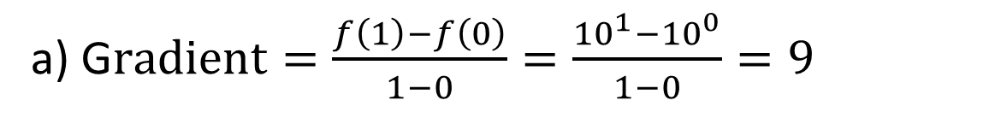
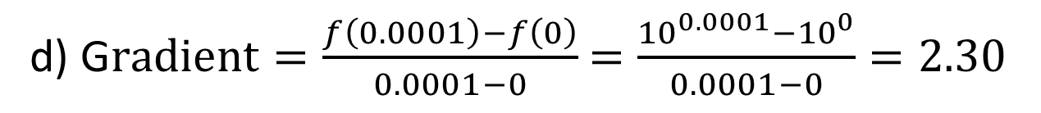
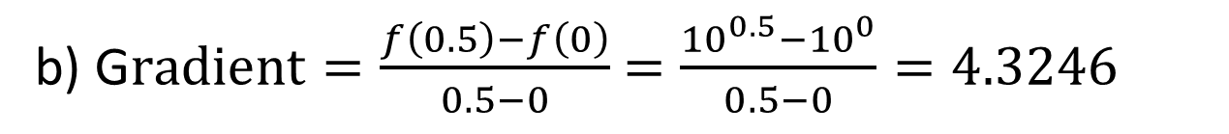
Guided Practice
a) G$radient=\frac{f\left(1\right)−f\left(0\right)}{1−0}=\frac{{10}^{1}−{10}^{0}}{1−0}=9$
b) G$radient=\frac{f\left(0.5\right)−f\left(0\right)}{0.5−0}$ $=\frac{{10}^{0.5}−{10}^{0}}{0.5−0}=4.3246$
c) G$radient=\frac{f\left(0.1\right)−f\left(0\right)}{0.1−0}$ $=\frac{{10}^{0.1}−{10}^{0}}{0.1−0}=2.5893$
d) G$radient=\frac{f\left(0.0001\right)−f\left(0\right)}{0.0001−0}$ $=\frac{{10}^{0.0001}−{10}^{0}}{0.0001−0}=2.30$

Slide 7
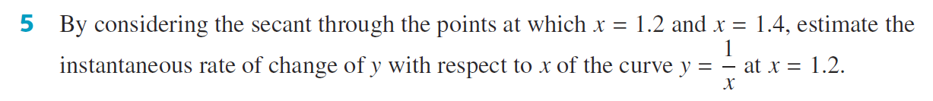
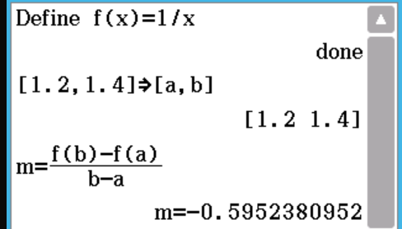
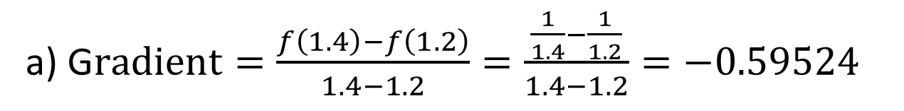
Guided Practice
a) G$radient=\frac{f\left(1.4\right)−f\left(1.2\right)}{1.4−1.2}=\frac{\frac{1}{1.4}−\frac{1}{1.2}}{1.4−1.2}=−0.59524$

Slide 8
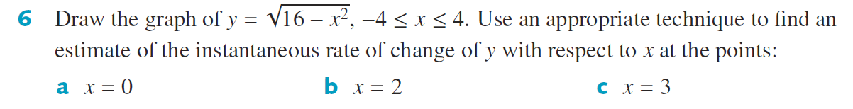
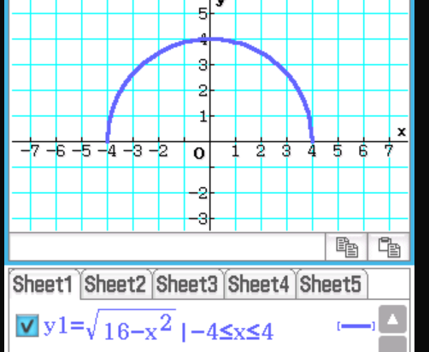
Guided Practice
a) When a tangent line is drawn at x=0, it is a horizontal line. Gradient of horizontal line = 0
b) To find gradient of tangent at x=2, find gradient of line that passes through x=1.9 and x = 2.1
G$radient=\frac{f\left(2.1\right)−f\left(1.9\right)}{2.1−1.9}=\frac{\sqrt{16−{\left(2.1\right)}^{2}}−\sqrt{16−{\left(1.9\right)}^{2}}}{2.1−1.9}=−0.57$
d) To find gradient of tangent at x=3, find gradient of line that passes through x=2.9 and x = 3.1
G$radient=\frac{f\left(3.1\right)−f\left(2.9\right)}{3.1−2.9}=\frac{\sqrt{16−{\left(3.1\right)}^{2}}−\sqrt{16−{\left(2.9\right)}^{2}}}{3.1−2.9}=−1.14$

Slide 9
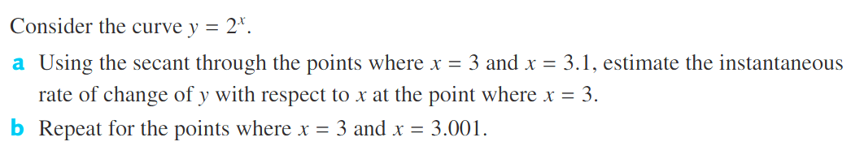




Guided Practice
a) Find the gradient of the secant that passes the points x = 3 and x =3.1
b) Find the gradient of the secant that passes the points x = 3 and x =3.001
G$radient=\frac{f\left(3.1\right)−f\left(3\right)}{3.1−3}$
G$radient=\frac{f\left(3.001\right)−f\left(3\right)}{3.001−3}$
$$=\frac{8.5741−8}{3.1−3}$$
$$=\frac{8.0055741−8}{3.001−3}$$
$$=5.742$$
$$=5.547$$
If we continue doing this, and find the gradient between the points x = 3 and $x=3+δ$, where $δ$ is small (eg $δ=0.000001)$, the gradient will approximate to 5.54

Slide 10
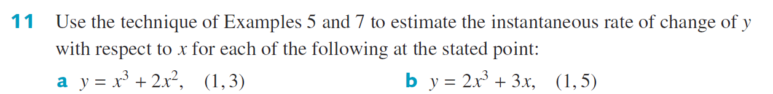
Guided Practice
a) Find the gradient of the chord that passes the points x = 0.9 and x =1.1
G$radient=\frac{f\left(0.9\right)−f\left(1\right)}{0.9−1}=7.01$
Find the gradient of the chord that passes the points x = 0.999 and x =1.001
G$radient=\frac{f\left(0.999\right)−f\left(1.001\right)}{0.999−1.001}=7.00$
∴ the instantaneous rate of change is approx.. 7
b) Find the gradient of the chord that passes the points x = 0.9 and x =1.1
G$radient=\frac{f\left(0.9\right)−f\left(1\right)}{0.9−1}=9.02$
Find the gradient of the chord that passes the points x = 0.999 and x =1.001
G$radient=\frac{f\left(0.999\right)−f\left(1.001\right)}{0.999−1.001}=9.00$
∴ the instantaneous rate of change is approx. 9

Slide 11
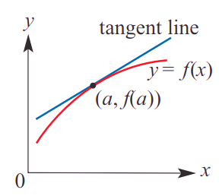



Summary
Given a function $y=f\left(x\right)$,
The instantaneous rate of change of $y$ with respect to $x$ at the point $(a, f\left(a\right))$
Is the gradient of the tangent line to the graph at the point$(a, f\left(a\right))$

Slide 12
Independent Practice
Complete Cambridge Ex 17B

